Slide 1

North American EEHV Workshop
March 26-28, 2019
Houston, Texas, USA

Slide 2


Slide 3










Sponsors

Slide 4
Website: eehvinfo.org

Slide 5
EEHV Advisory Group
The mission of the EEHV Advisory Group is to decrease elephant morbidity and mortality due to EEHV while supporting elephant-holding institution programming by:
Disseminating knowledge of current best practices for prevention, diagnosis, and treatment of EEHV
Providing private and public elephant-holding facilities with technical assistance
Facilitating research by building international collaborations

Slide 6
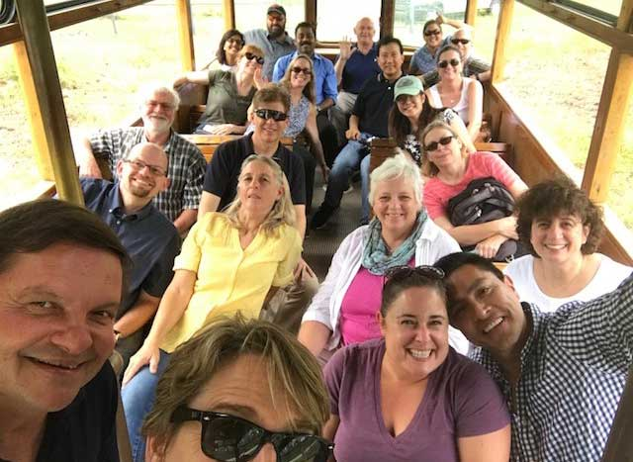
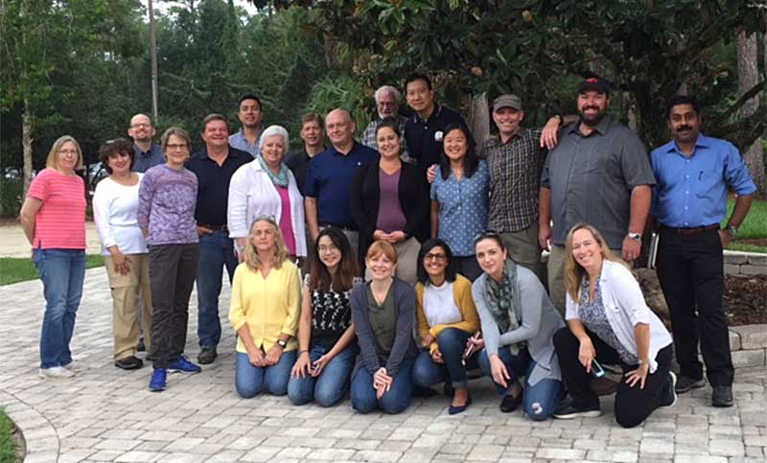
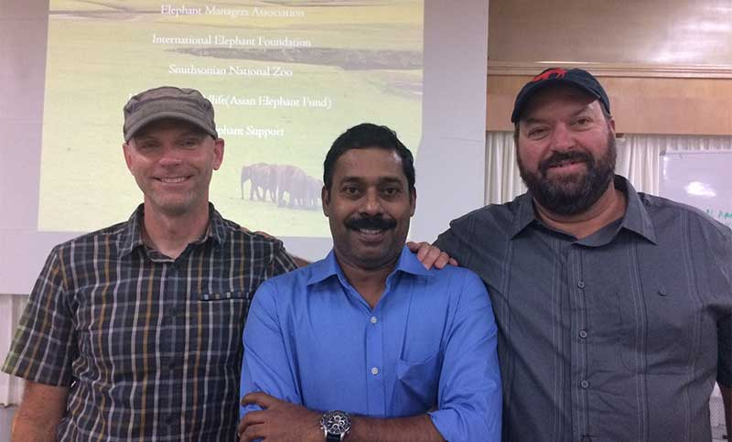
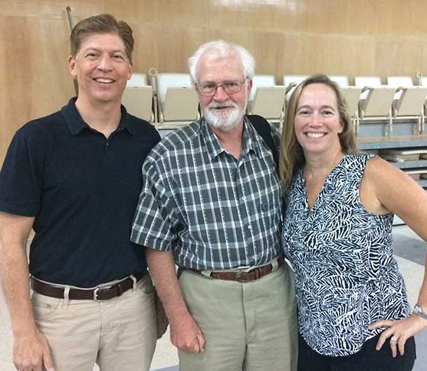
EEHV Advisory Group Meeting August 2018
White Oak Conservation Center, Florida, USA

Slide 7
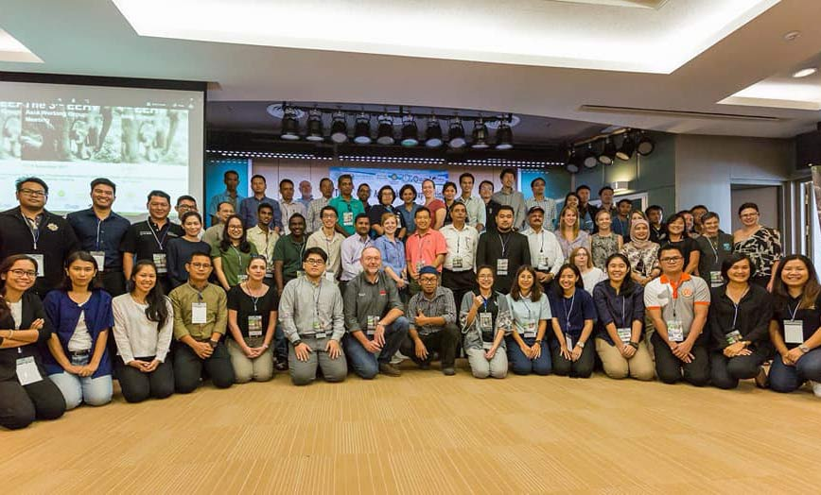
EEHV Asia Working Group Meeting November 2017
Kasetsart University, Thailand

Slide 8
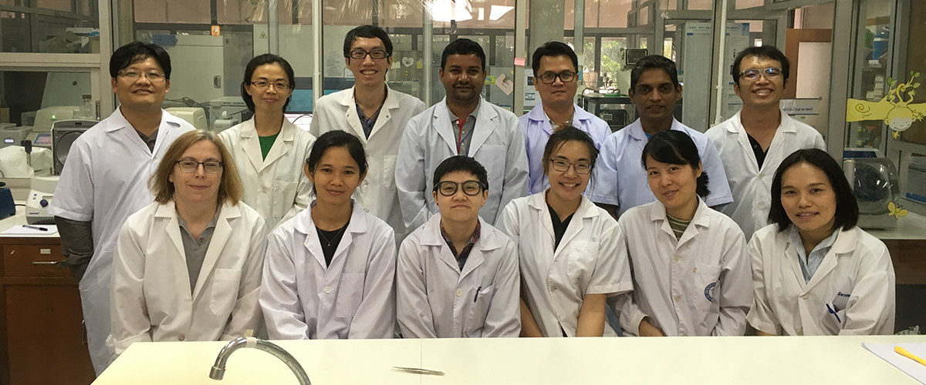
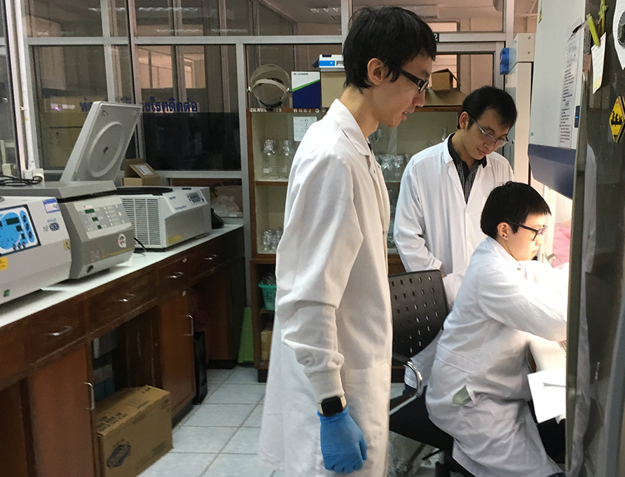
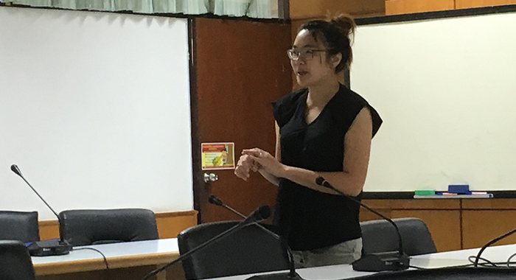

EEHV Asia Working Group Meeting November 2017
Kasetsart University, Thailand

Slide 9
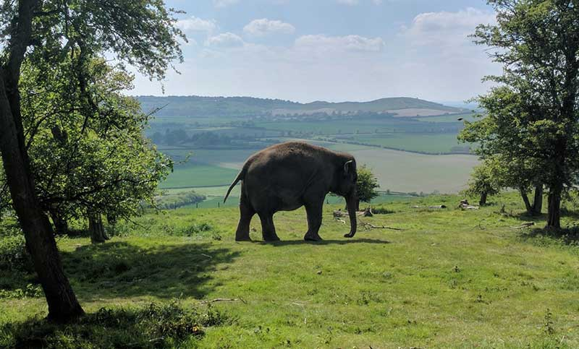
International EEHV Workshop May 2017
ZSL London Zoo and Whipsnade Zoo, London, UK

Slide 10
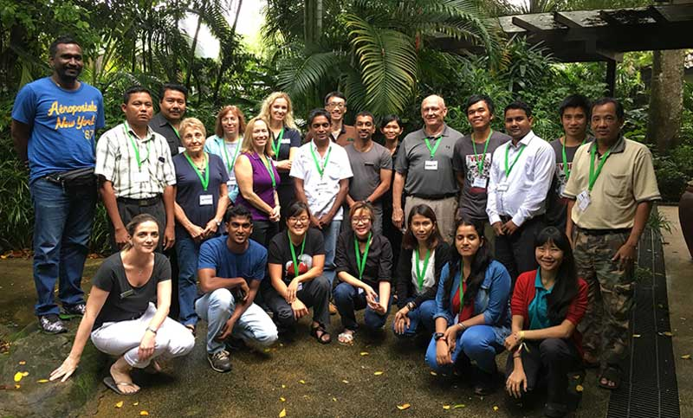
EEHV Asia Working Group Meeting December 2016
Singapore

Slide 11
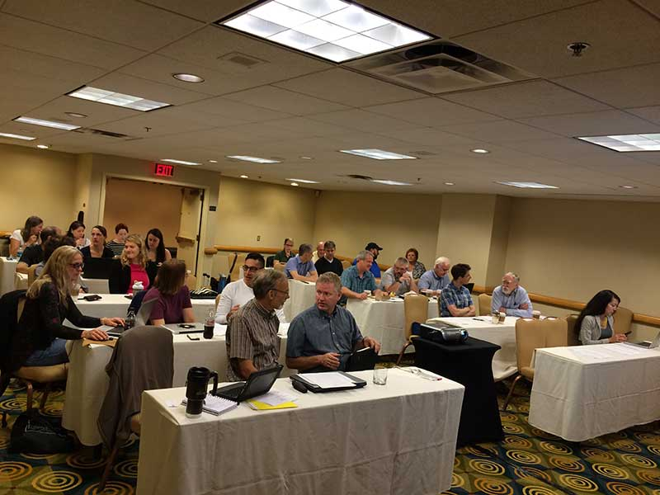
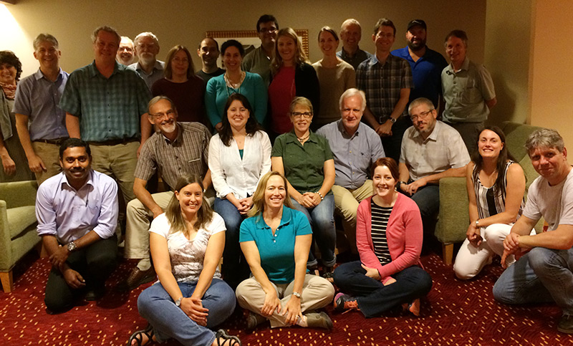
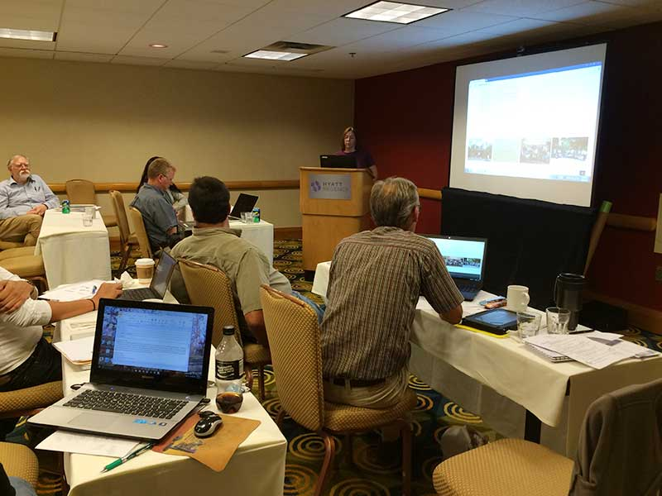
EEHV Advisory Group Meeting July 2016
Georgia, USA

Slide 12
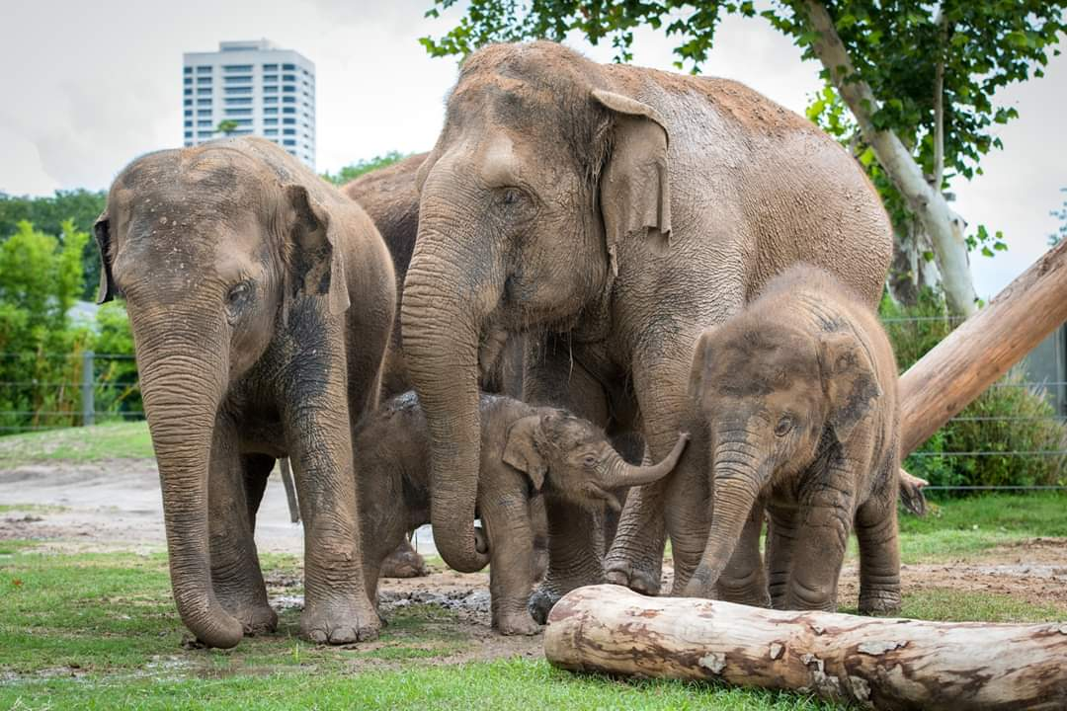
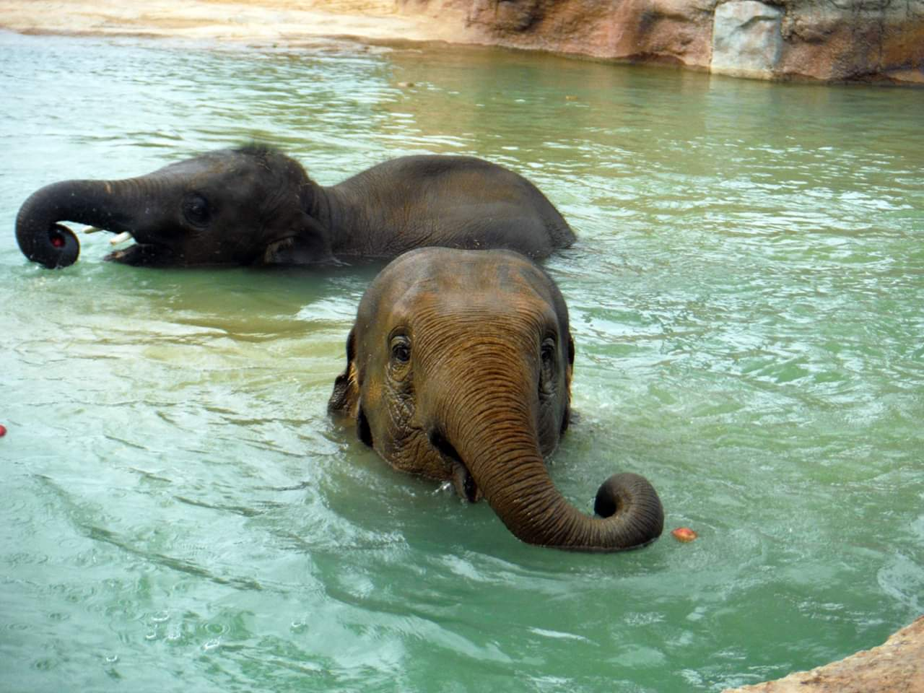
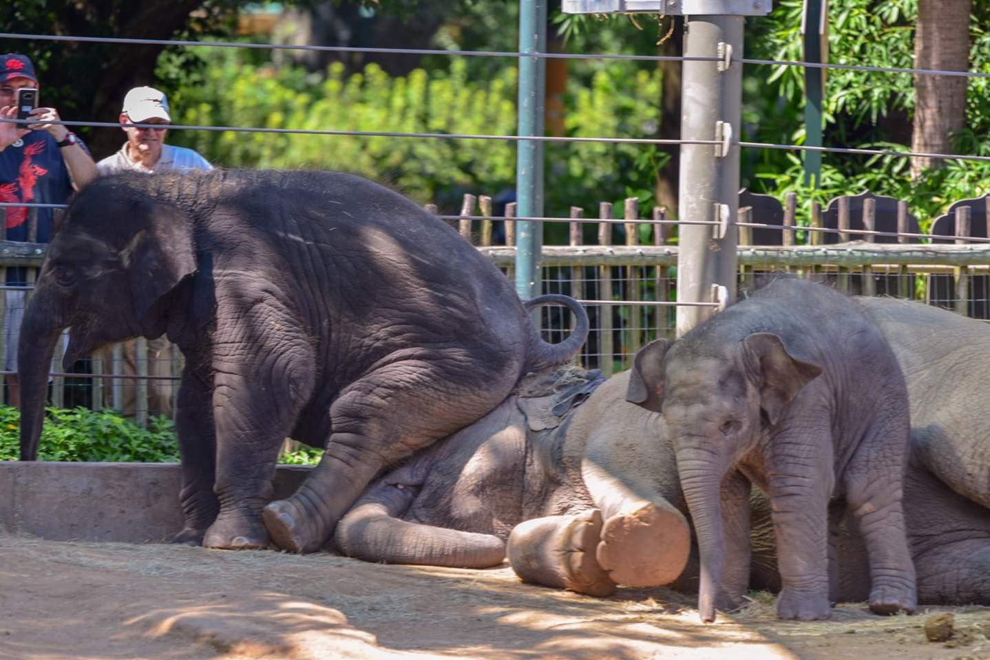
Meet the Houston Zoo’s Elephants
Image placement example

Slide 13
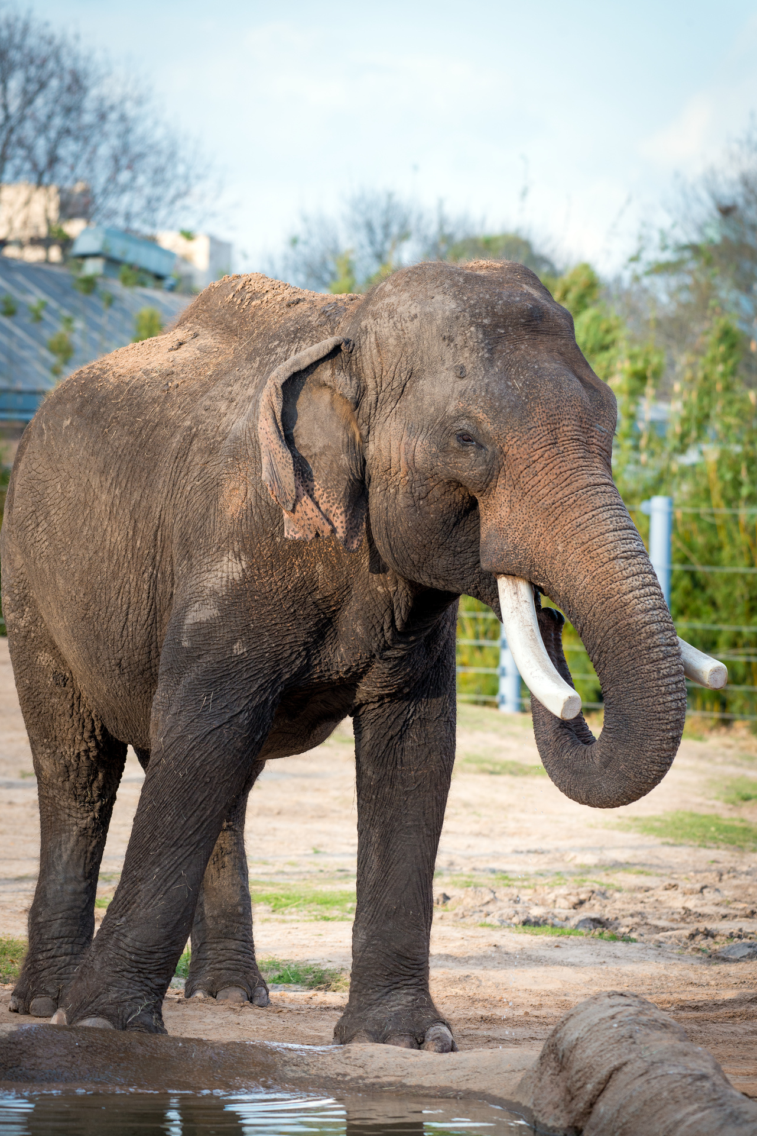
Meet the Houston Zoo’s Elephants
^{Name: Thai}
^{Sex: Male}
^{Age: 53 years}
^{Birthdate: June 16, 1965}
Image placement example

Slide 14
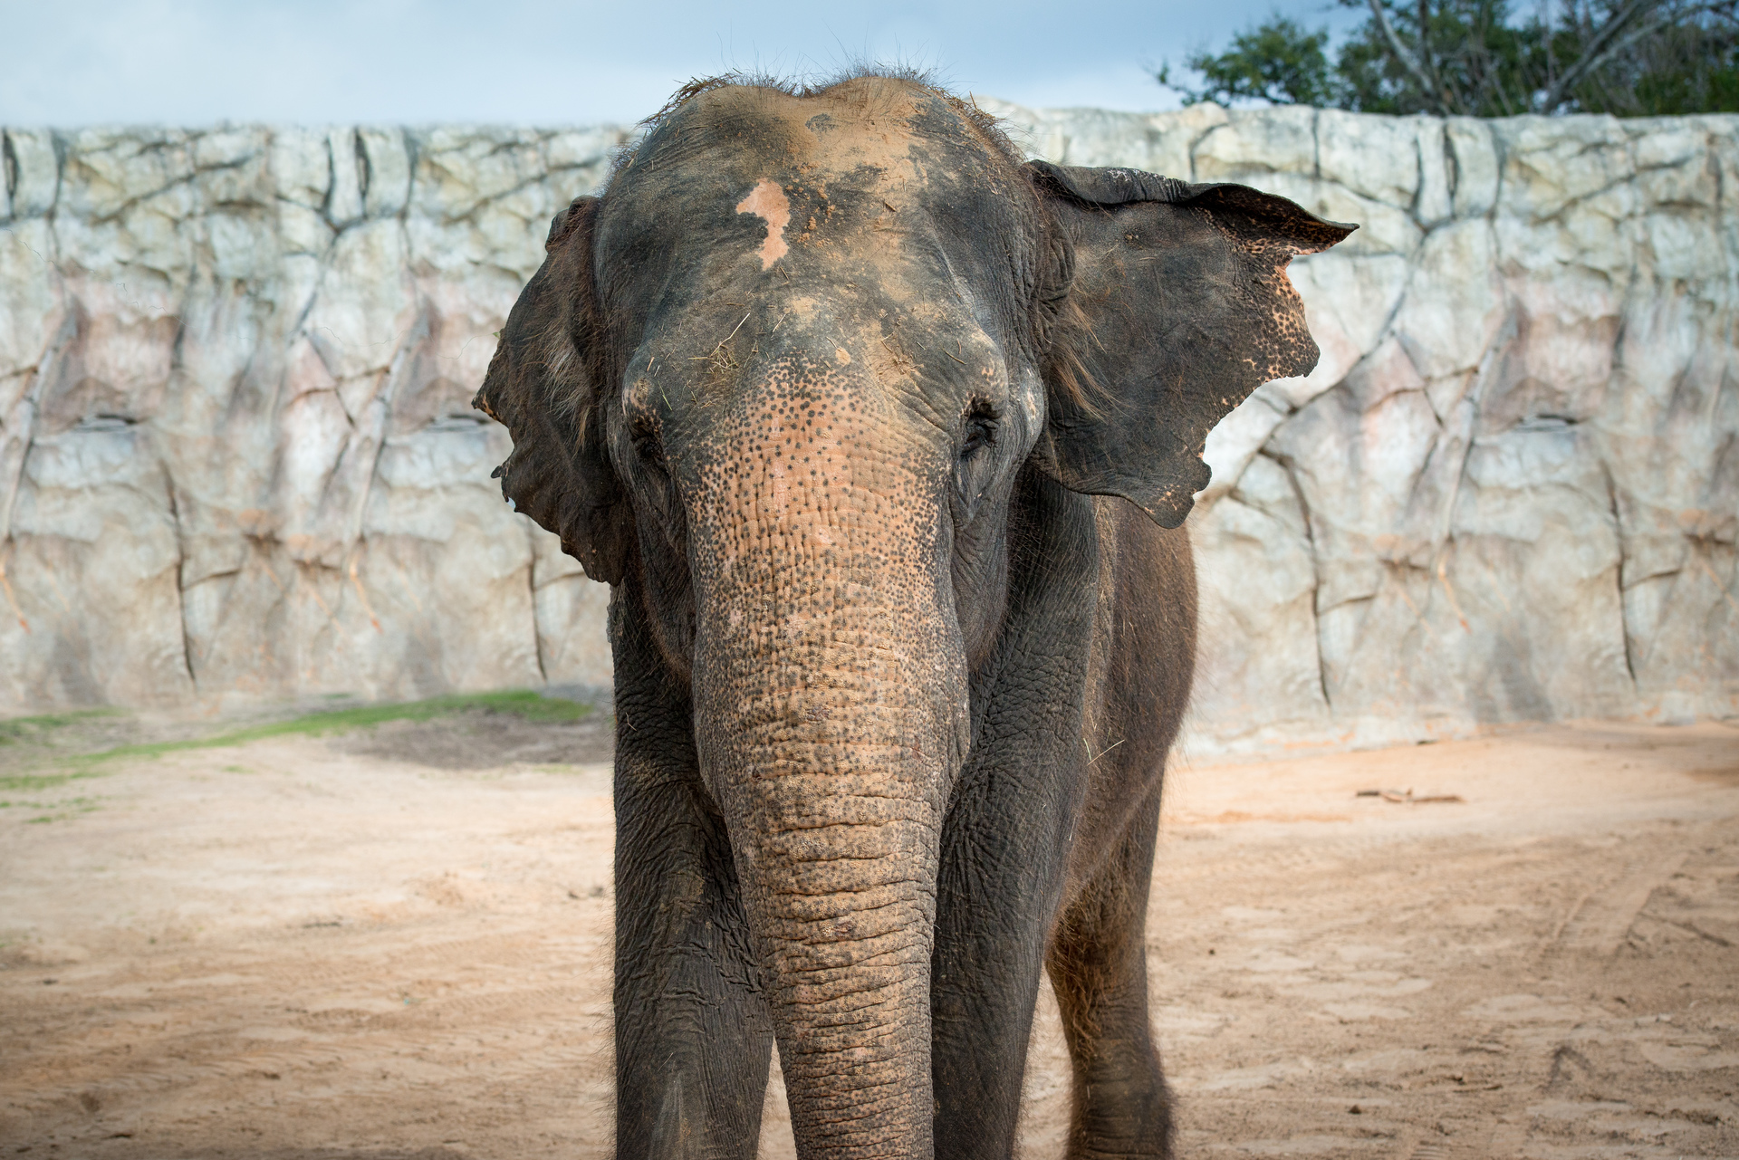
Meet the Houston Zoo’s Elephants
^{Name: Methai}
^{Sex: Female}
^{Age: 49 years}
^{Birthdate: May 11, 1969}
Image placement example

Slide 15
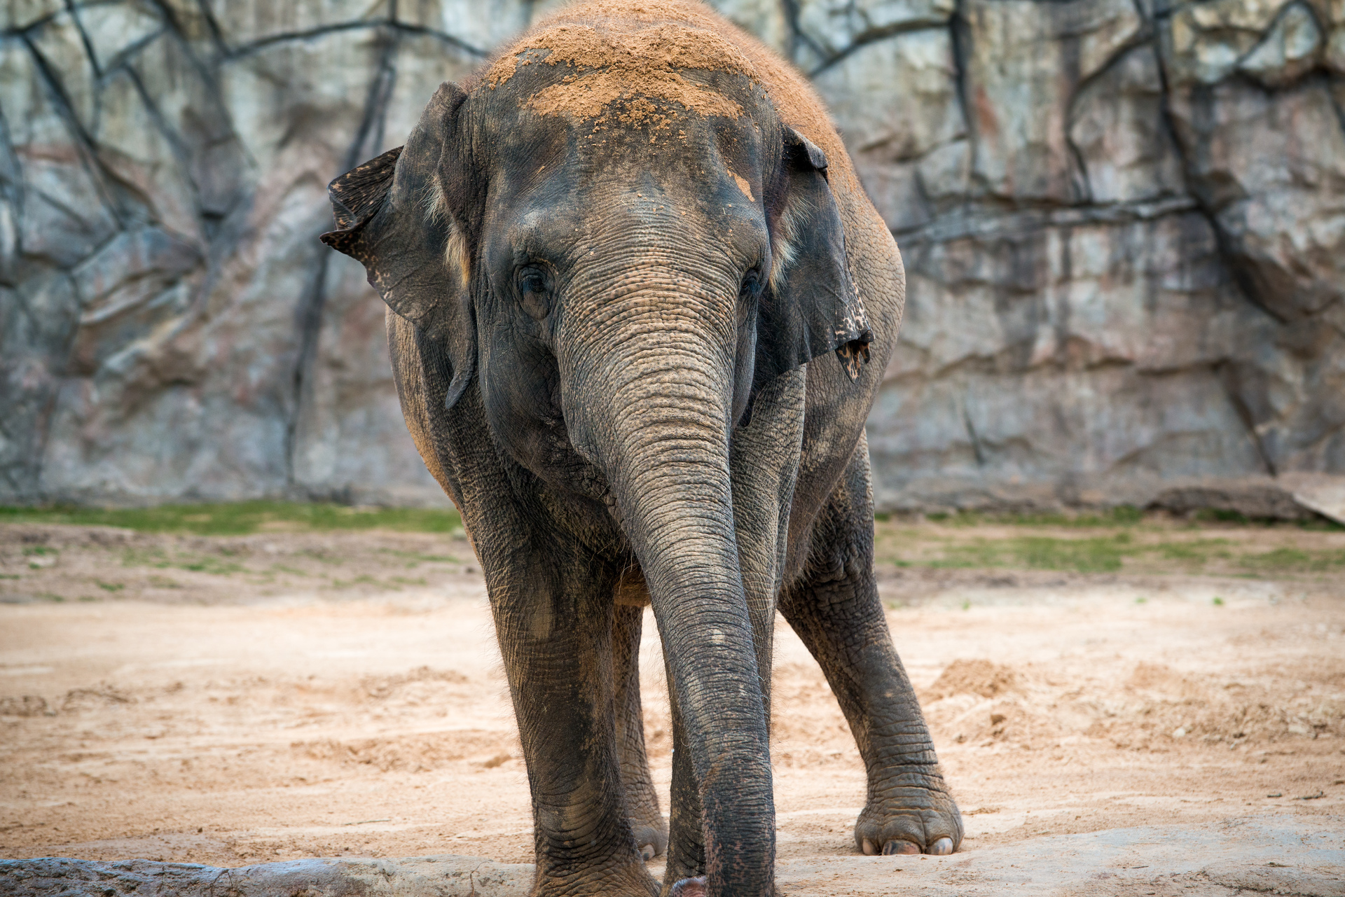
Meet the Houston Zoo’s Elephants
^{Name: Tess}
^{Sex: Female}
^{Age: 35 years}
^{Birthdate: July 1, 1983}
Image placement example

Slide 16
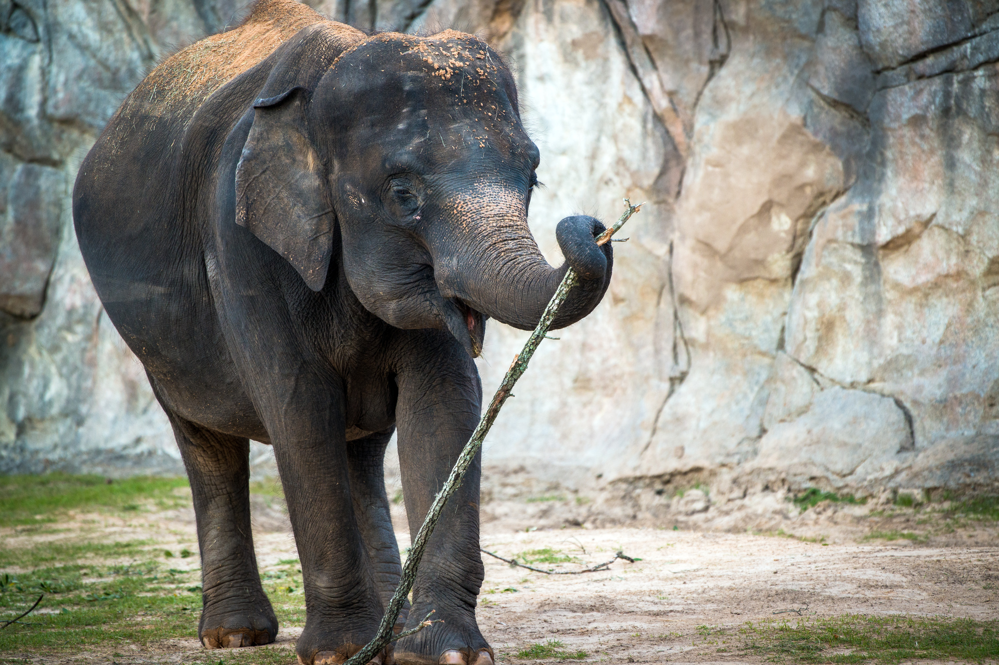
Meet the Houston Zoo’s Elephants
^{Name: Shanti}
^{Sex: Female}
^{Age: 28 years}
^{Birthdate: Oct 11, 1990}
Image placement example

Slide 17
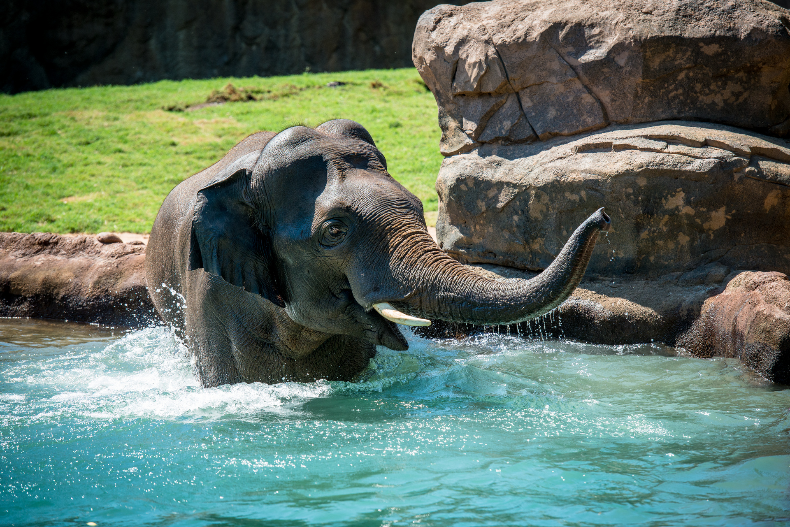
Meet the Houston Zoo’s Elephants
^{Name: Tucker}
^{Sex: Male}
^{Age: 13 years}
^{Birthdate: May 12, 2005}
Image placement example

Slide 18
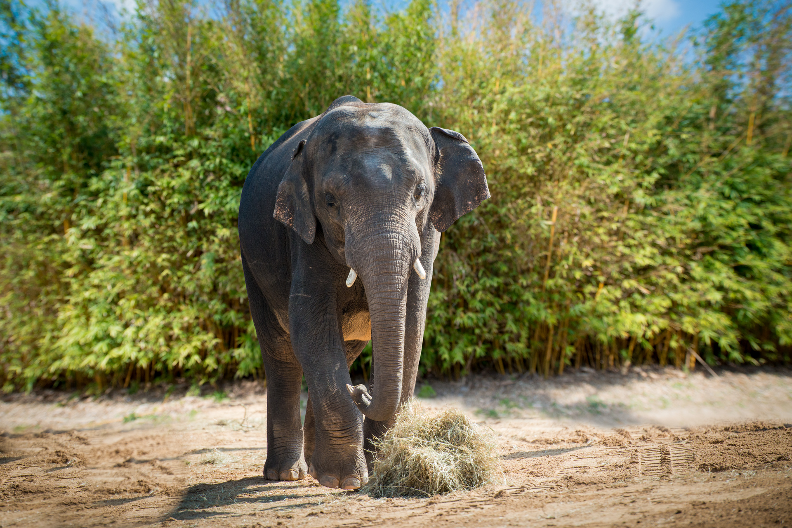
Meet the Houston Zoo’s Elephants
^{Name: Baylor}
^{Sex: Male}
^{Age: 8 years}
^{Birthdate: May 4, 2010}
Image placement example

Slide 19
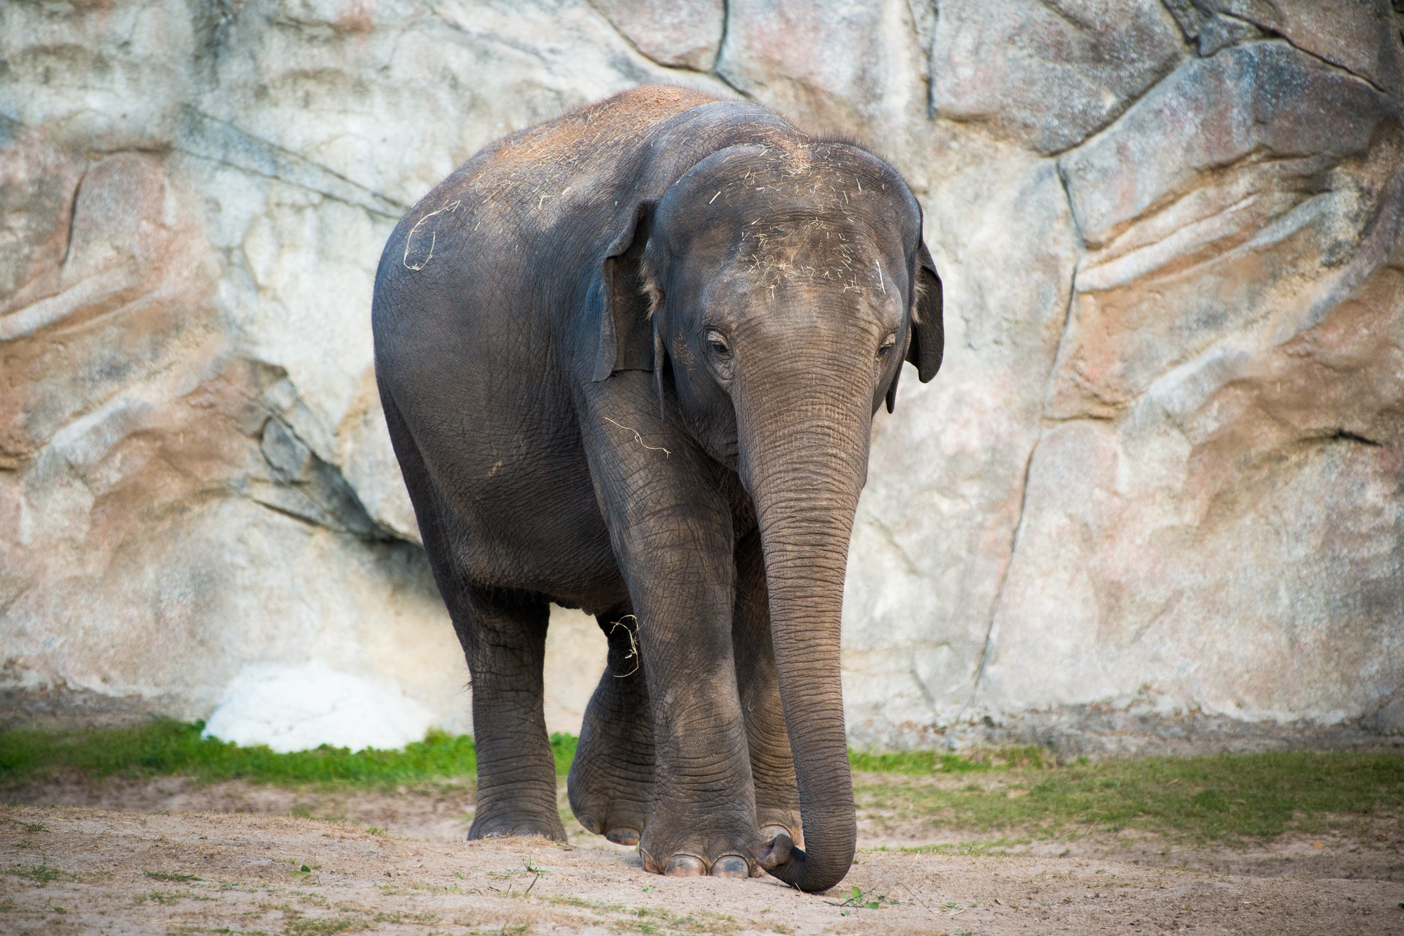
Meet the Houston Zoo’s Elephants
^{Name: Tupelo}
^{Sex: Female}
^{Age: 8 years}
^{Birthdate: Oct 3, 2010}
Image placement example

Slide 20
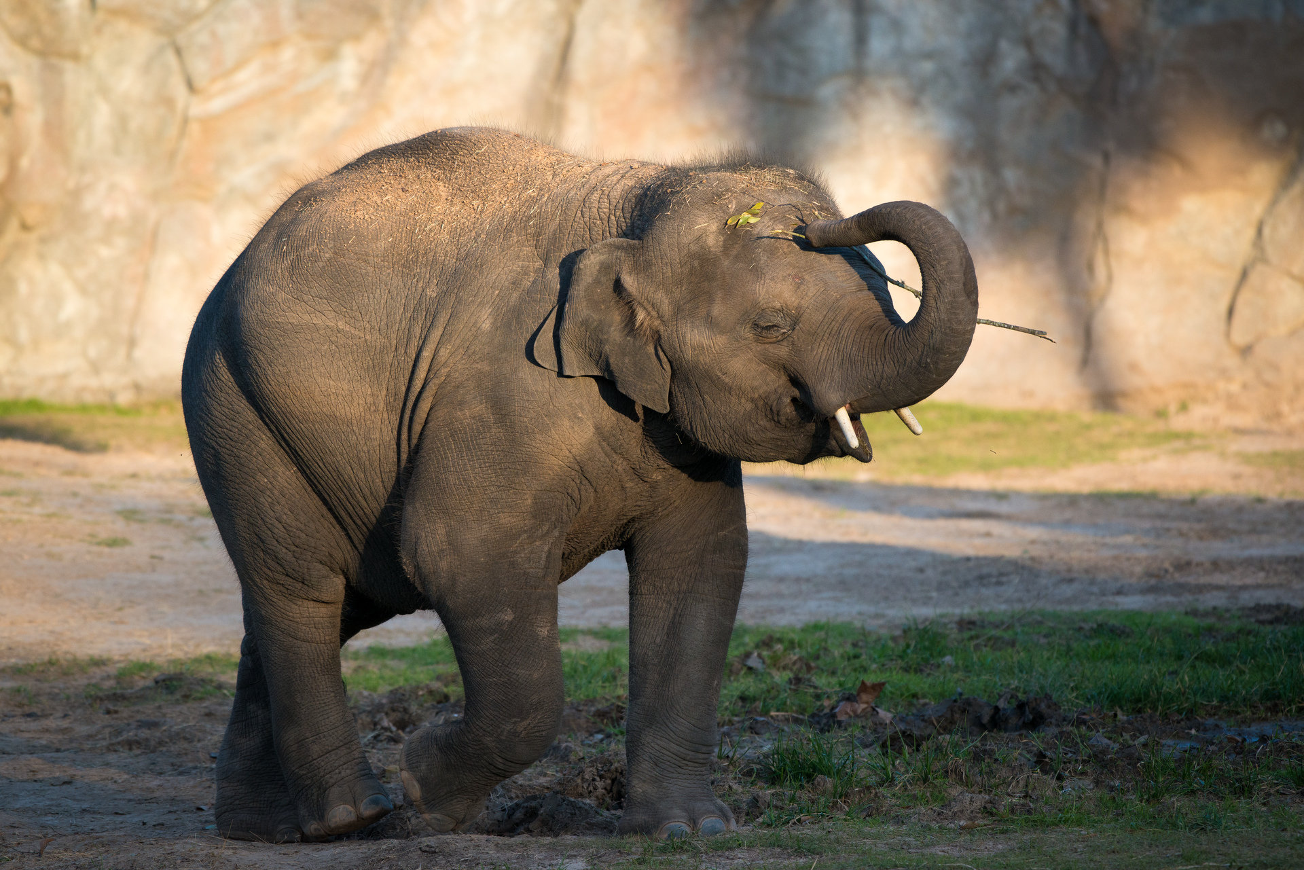
Meet the Houston Zoo’s Elephants
^{Name: Duncan}
^{Sex: Male}
^{Age: 5 years}
^{Birthdate: February 7, 2014}
Image placement example

Slide 21
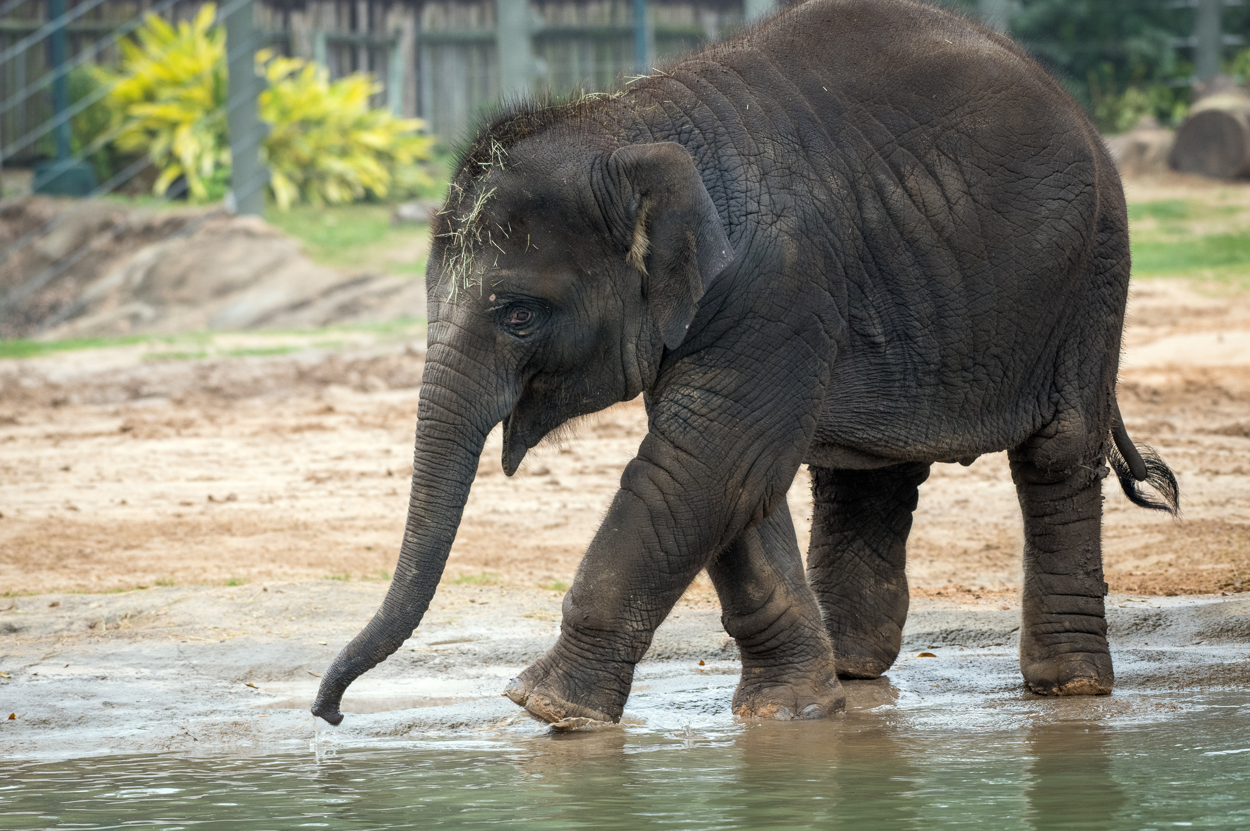
Meet the Houston Zoo’s Elephants
^{Name: Joy}
^{Sex: Female}
^{Age: 1 year, 8 months}
^{Birthdate: July 12, 2017}
Image placement example

Slide 22
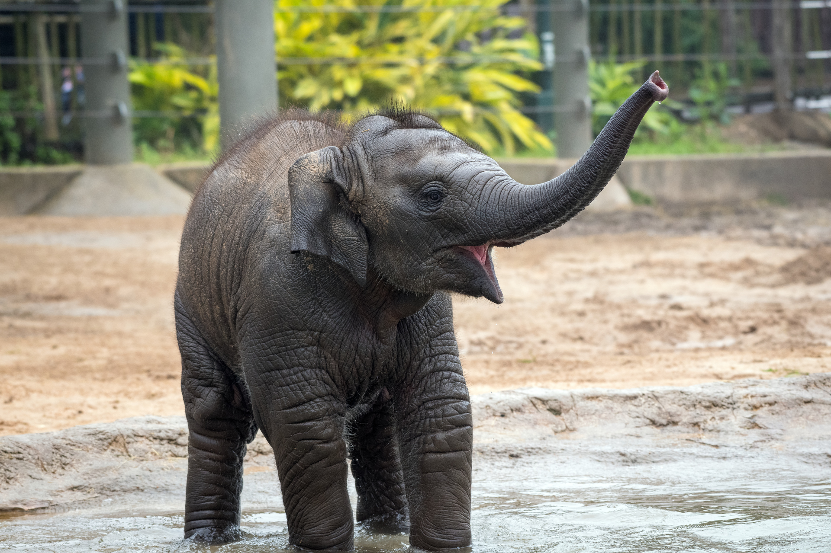
Meet the Houston Zoo’s Elephants
^{Name: Tilly}
^{Sex: Female}
^{Age: 9 months}
^{Birthdate: June 17, 2018}
Image placement example

